Slide 1
Why Learn AI
Michael

Slide 2
What is AI
Fast-developing
Interdisciplinary

Slide 3
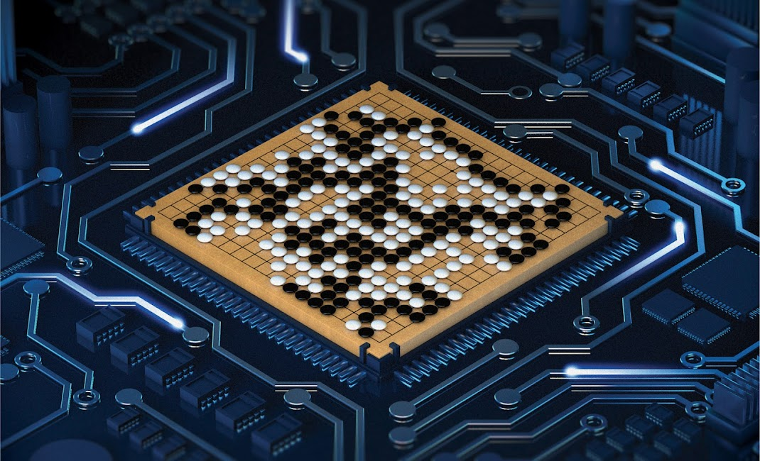
The Future of AI
2016

Slide 4
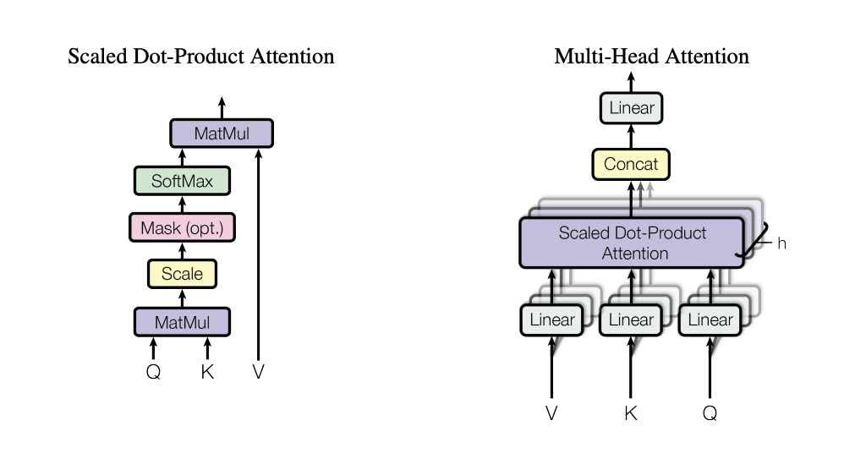
The Future of AI
June 2017

Slide 5

The Future of AI
2020

Slide 6
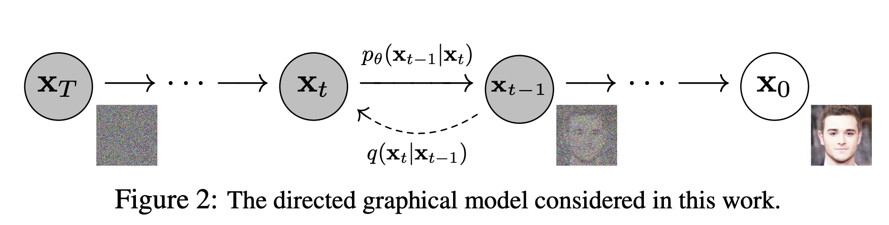
The Future of AI
June 2020
Ho., et al., 2020

Slide 7
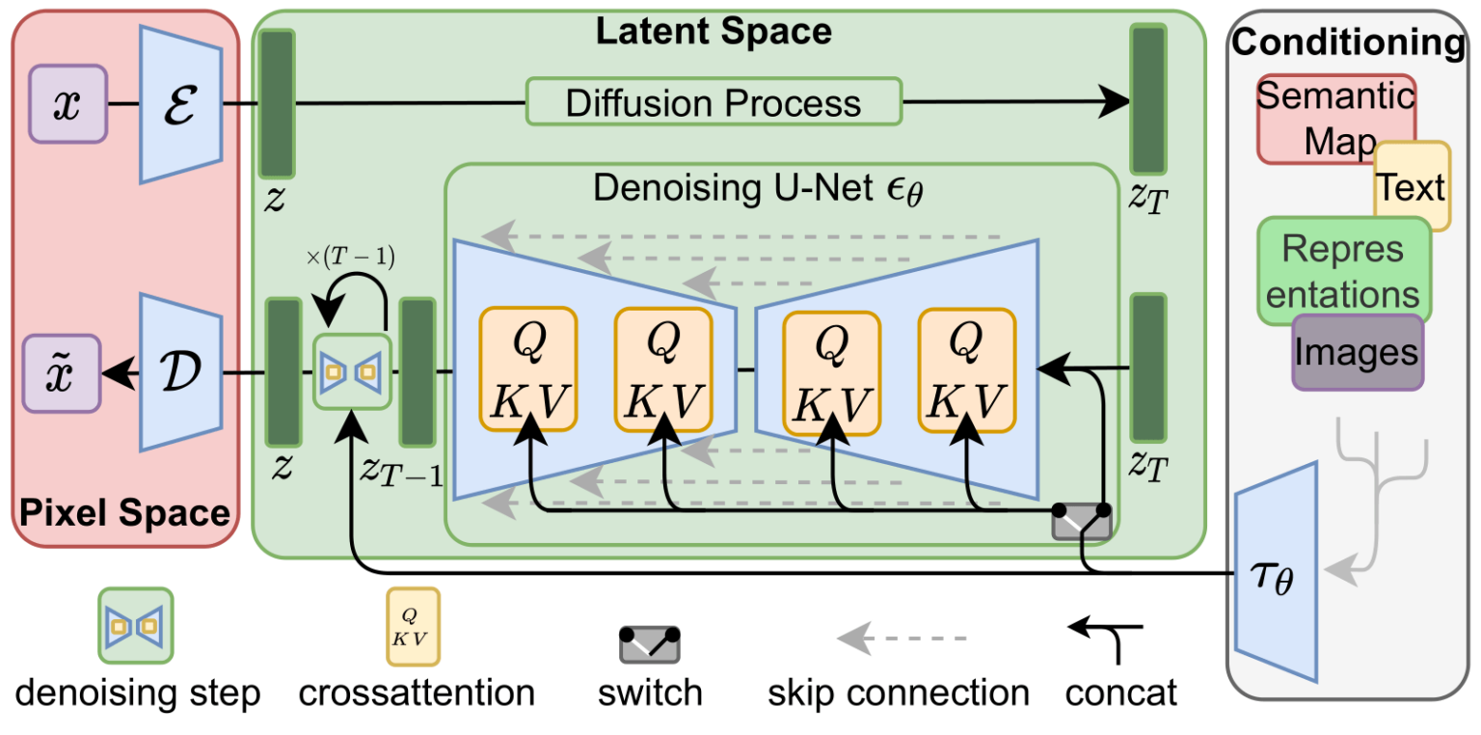
The Future of AI
April 2022
Rombach., et al., 2022

Slide 8

The Future of AI
July 2024
blackforestlabs.ai

Slide 9
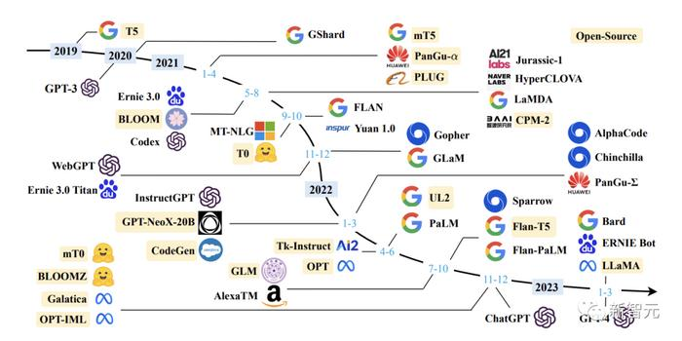
The Future is AI

